Slide 1
CS231. Nhập môn Thị giác máy tính
Image segmentation
Mai Tiến Dũng

Slide 2
Image Segmentation
Image segmentation is the operation of partitioning an image into a collection of connected sets of pixels.
Segmentation in easy words is assigning labels to pixels. All picture elements or pixels belonging to the same category have a common label assigned to them.

Slide 3
Image Segmentation
a
Feature
Extraction
Image Segmentation
Classification
Input Image
Feature Vector
Object Type
Object Image

Slide 4
Approaches in Image Segmentation
Similarity approach
Discontinuity approach

Slide 5
Approaches in Image Segmentation
1. Similarity approach:
Based on detecting similarity between image pixels to form a segment, based on a threshold.
ML algorithms like clustering are based on this type of approach to segment an image.

Slide 6
Approaches in Image Segmentation
2. Discontinuity approach:
This approach relies on the discontinuity of pixel intensity values of the image.
Line, Point, and Edge Detection techniques use this type of approach for obtaining intermediate segmentation results which can be later processed to obtain the final segmented image.

Slide 7
Groups of image segmentation
Semantic segmentation
Instance segmentation

Slide 8
Groups of image segmentation
Semantic segmentation is an approach detecting, for every pixel, belonging class of the object.
For example, when all people in a figure are segmented as one object and background as one object.

Slide 9
Groups of image segmentation
Instance segmentation is an approach that identifies, for every pixel, a belonging instance of the object. It detects each distinct object of interest in the image. For example, when each person in a figure is segmented as an individual object.

Slide 10
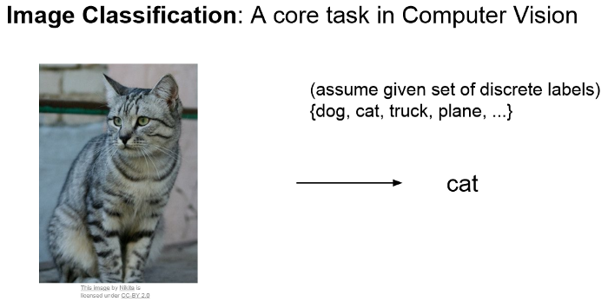
Groups of image segmentation

Slide 11
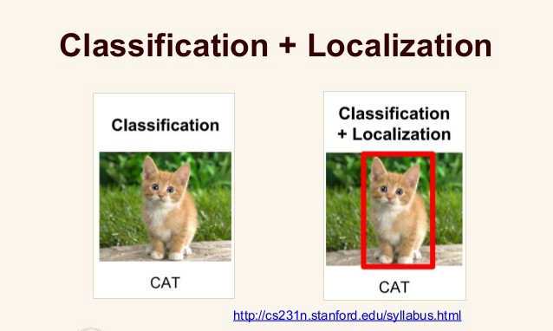
Groups of image segmentation

Slide 12
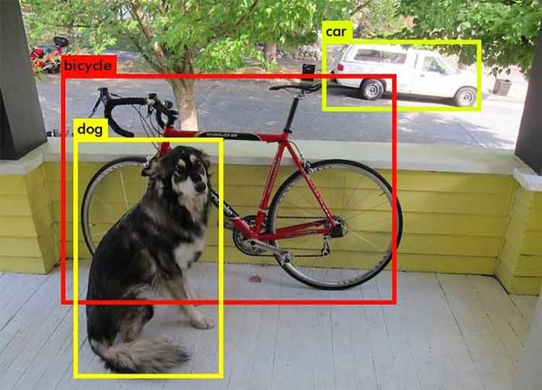
Groups of image segmentation
Object Detection
🡪 to classify and localize all the objects in the image

Slide 13
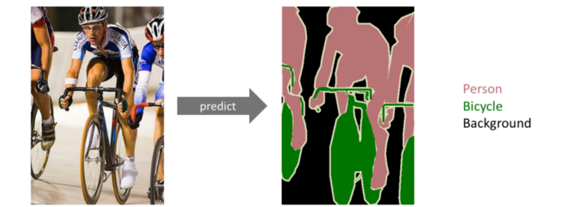
Groups of image segmentation
Semantic Segmentation
The goal of semantic image segmentation is to label each pixel of an image with a corresponding class of what is being represented. Because we’re predicting for every pixel in the image, this task is commonly referred to as dense prediction.

Slide 14
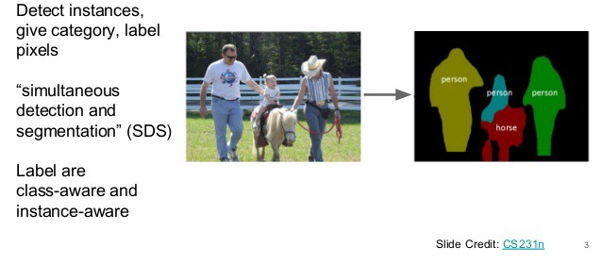
Groups of image segmentation
Instance segmentation
🡪 to classify each instance of a class separately

Slide 15
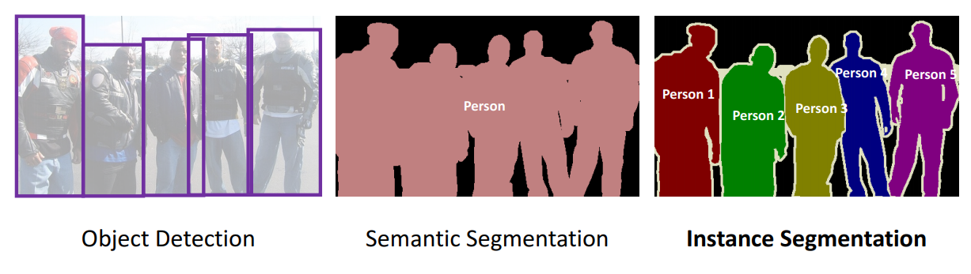
Groups of image segmentation

Slide 16
Image Segmentation Techniques
Threshold Based Segmentation
Edge Based Segmentation
Region-Based Segmentation
Clustering Based Segmentation
Artificial Neural Network Based Segmentation

Slide 17
1. THRESHOLD BASED SEGMENTATION

Slide 18
Threshold Based Segmentation
To create a binary or multi-color image based on setting a threshold value on the pixel intensity of the original image.
How to find an automatic threshold ?
🡪 considering variations in illumination & surface
One popular approach : histogramming

Slide 19
Threshold Based Segmentation
Consider the intensity histogram of all the pixels in the image 🡪 then we will set a threshold to divide the image into sections.

Slide 20
Thresholding techniques
Global thresholding
Manual thresholding
Adaptive Thresholding
Optimal Thresholding
Local Adaptive Thresholding

Slide 21
Thresholding techniques: Global
Use a bimodal image 🡪 with 2 peaks of intensities in the intensity distribution plot.
One for the object and
One for the background.
Deduce the global threshold value for the whole image.
A disadvantage of this type of threshold is that it performs really poorly during poor illumination in the image.

Slide 22
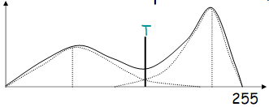
Thresholding techniques: Global
Find the “peaks” and “valleys” of the histogram
Set threshold to the pixel value of the “valley”
Non-trivial to find peaks/valleys :
ignore local peaks; choose peaks at a distance find the valley between those peaks
Maximize “peakiness” (difference btw peaks & valleys) to find the threshold as valley

Slide 23
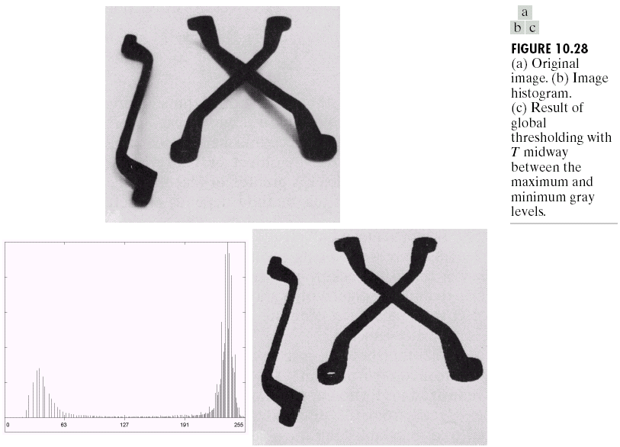

Slide 24
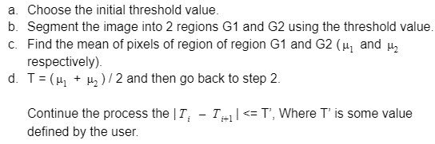
Thresholding techniques: Manual
Iterative threshold selection
The following process goes as follows

Slide 25
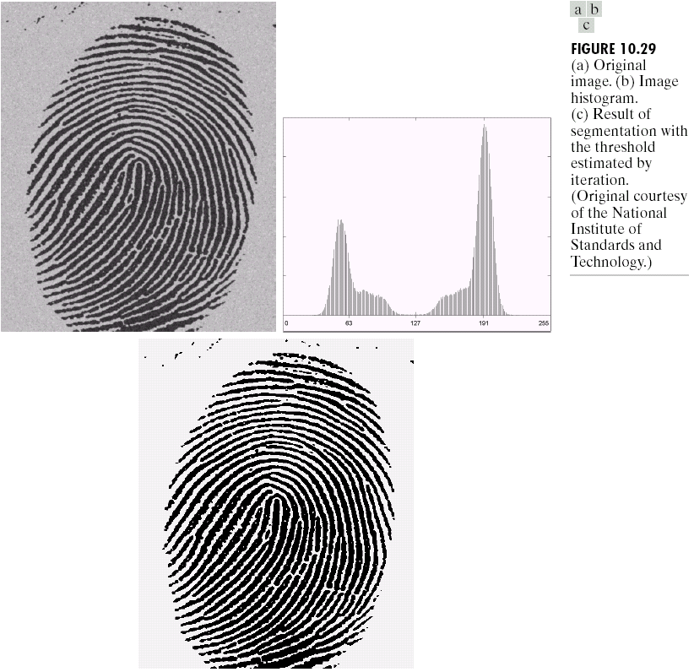
Thresholding techniques: Manual

Slide 26
Thresholding techniques: Adaptive
To overcome the effect of illumination, the image is divided into various subregions, and all these regions are segmented using the threshold value calculated for all these regions. Then these subregions are combined to image the complete segmented image.
This helps in reducing the effect of illumination to a certain extent.

Slide 27
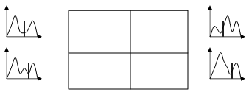
Thresholding techniques: Adaptive

Slide 28
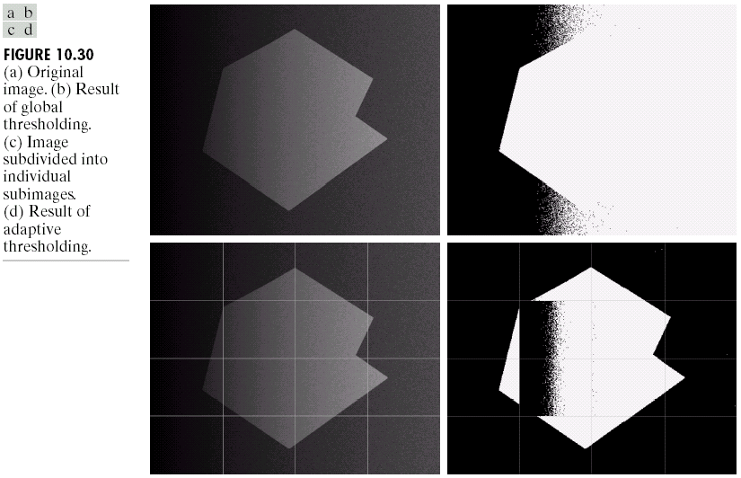
Thresholding techniques: Adaptive

Slide 29
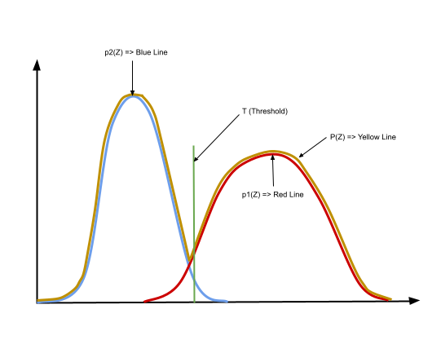
Thresholding techniques: Optimal
Optimal thresholding technique can be used to minimize the misclassification of pixels performed by segmentation.

Slide 30



Thresholding techniques: Optimal
The probability of a pixel value is given by the following formulae :

Slide 31
Thresholding techniques: Local Adaptive
Due to variation in the illumination of pixels in the image, global thresholding might have difficulty in segmenting the image.
Hense the image is divided into smaller subgroups and then adaptive thresholding of those individual groups is done.

Slide 32
Thresholding techniques: Local Adaptive
After individual segmentation of these subgroups, all of them are combined to form the completed segmented image of the original image.
Hence, the histogram of subgroups helps in providing better segmentation of the image.

Slide 33
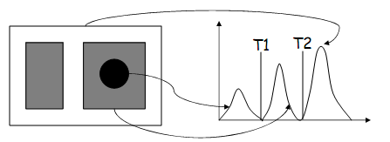
Thresholding techniques: Double
Starting from a conservative initial threshold T1, determine the “core” parts of the object
Continuing from this core part, grow this object by including neighboring pixels which are between T1 and T2

Slide 34
Thực hành 1
Áp dụng phân đoạn ảnh cho các ảnh:
particles.bmp
Phandoan01.jpg
wdg2.jpg
son1.jpg

Slide 35
Edge Based Segmentation

Slide 36
Edge Based Segmentation
Rely on edges found in an image using various edge detection operators.
These edges mark image locations of discontinuity in gray levels, color, texture, etc. When we move from one region to another, the gray level may change. So if we can find that discontinuity, we can find that edge.

Slide 37
Edge Based Segmentation
A variety of edge detection operators are available but the resulting image is an intermediate segmentation result and should not be confused with the final segmented image.
We have to perform further processing on the image to the segment it.

Slide 38
Edge Based Segmentation
Additional steps include combining edges segments obtained into one segment in order to reduce the number of segments rather than chunks of small borders which might hinder the process of region filling. This is done to obtain a seamless border of the object.
The goal of edge segmentation is to get an intermediate segmentation result to which we can apply region-based or any other type of segmentation to get the final segmented image.

Slide 39
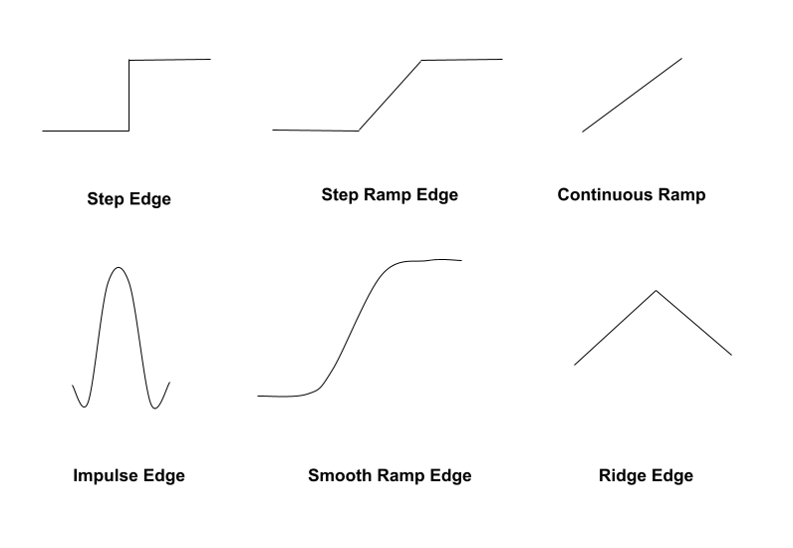
Types of edges

Slide 40
Tham khảo bài học về thông tin cạnh - edge

Slide 41
Clustering-Based Segmentation

Slide 42
Clustering-Based Segmentation
Clustering is a type of unsupervised machine learning algorithm. It is highly used for the segmentation of images.
One of the most dominant clustering-based algorithms used for segmentation is K-means Clustering. This type of clustering can be used to make segments in a colored image.

Slide 43
Partitioning Clustering
Partitioning Clustering methods subdivides the data into k groups, where k is a number predefined by the user. For K-means Clustering which is the most popular Partitioning Cluster method

Slide 44
K-means
Algorithm:
We choose k random points in the data as the center of clusters and assign each point to the nearest cluster by looking at the L2 distance between the point and the center.
Compute the mean of each cluster, assign that mean value as the new center of the cluster.
Reassign each data point to its closest cluster center. Repeat step 2.
The process keeps going until no new assignment is performed (so the model is converged, there is nothing to go furthermore) or for a given number of iteration. Therefore, K-means Clustering is an iterative method where we can determine the iteration number too.

Slide 45
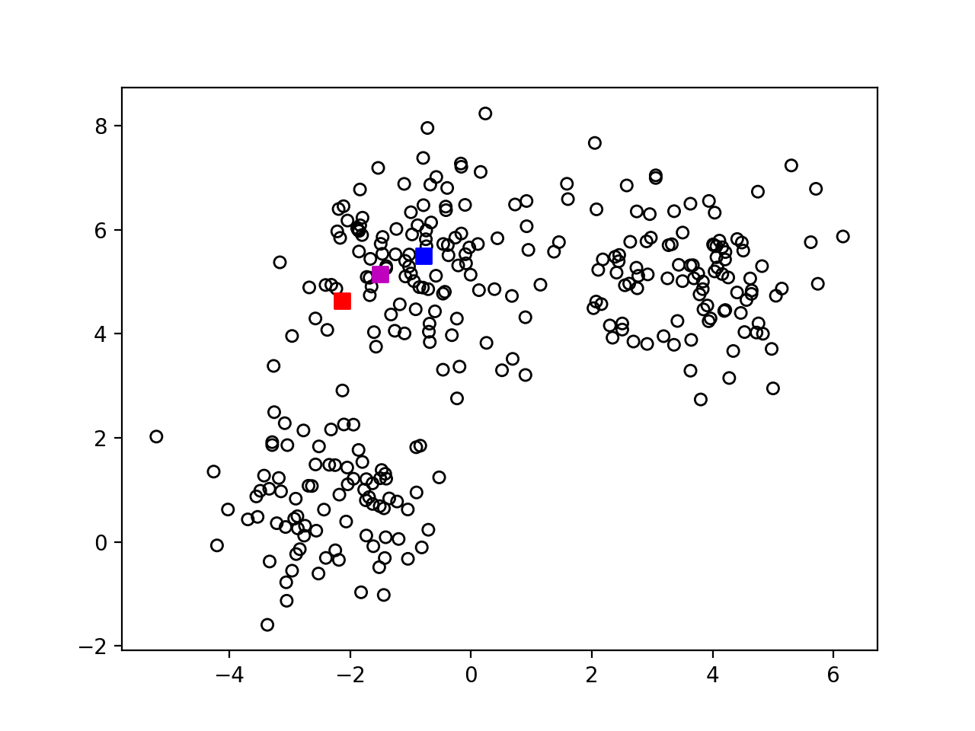
K-means
Step-1 : randomly pick k centers

Slide 46
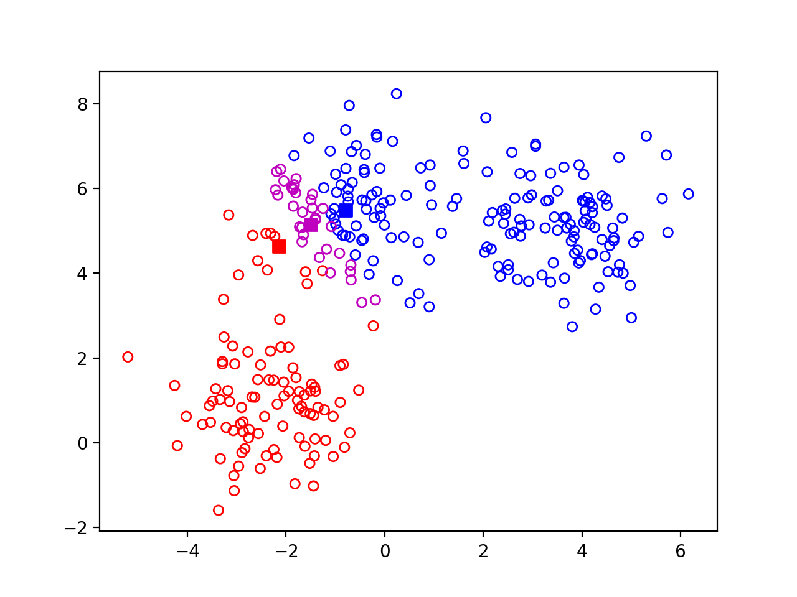
K-means
Step 2: Assign each point to nearest center

Slide 47

K-means
Step 3: re-estimate centers

Slide 48

K-means
Step 4: Repeat

Slide 49
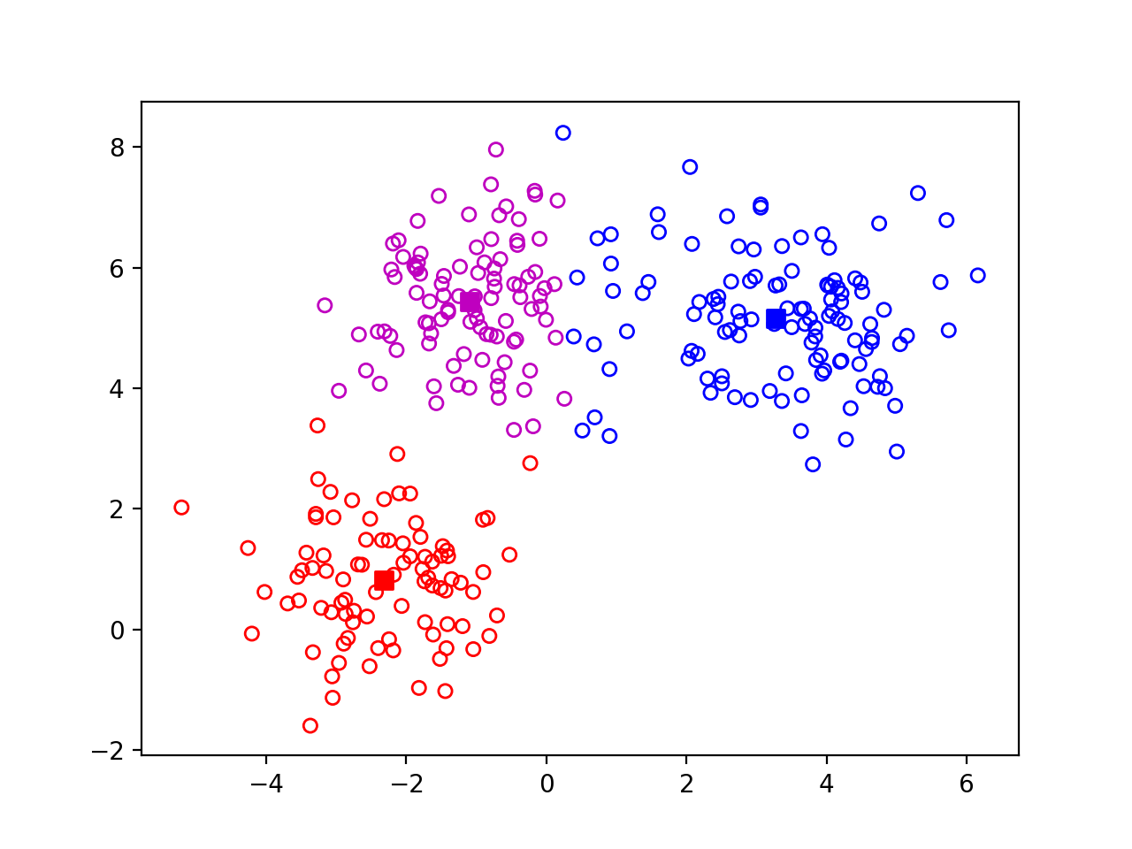
K-means
Step 4: Repeat

Slide 50
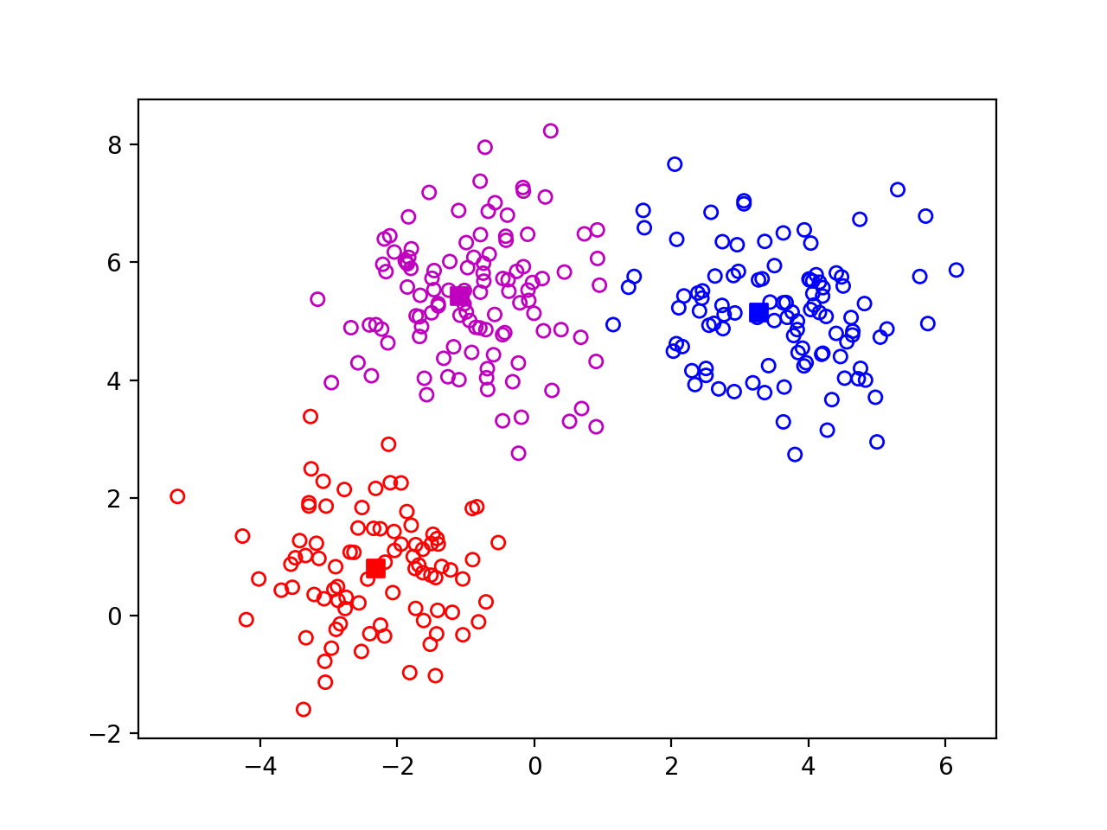
K-means
Step 4: Repeat

Slide 51
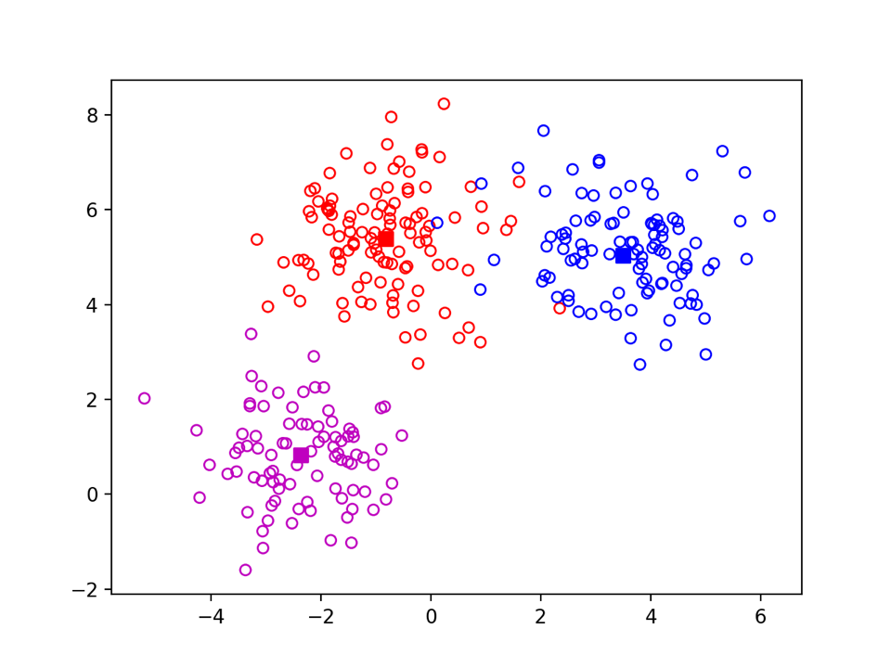

K-means
Ground-truth vs k-means
Ground truth
K-means 100 iterations

Slide 52
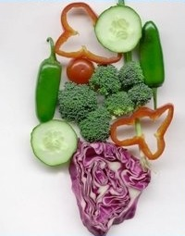
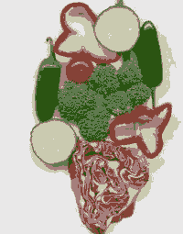
K-means on image pixels
path_filename = os.path.join(dir_baitap, 'vegetables.jpg')
img = cv.imread(path_filename)
cv2_imshow(img)
nrow, ncol,nchl = img.shape
g = img.reshape(nrow*ncol,nchl)
from sklearn.cluster import KMeans
k_means = KMeans(n_clusters = 6, random_state = 0).fit(g)
t = k_means.cluster_centers_[k_means.labels_]
img_res = t.reshape(nrow, ncol, nchl)
cv2_imshow(img_res)

Slide 53
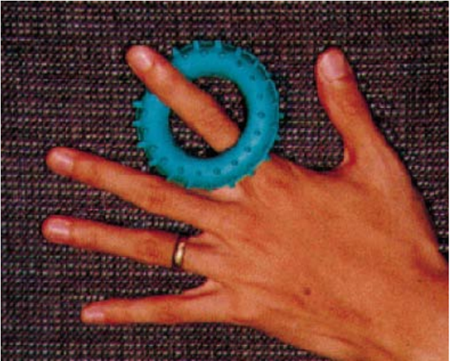
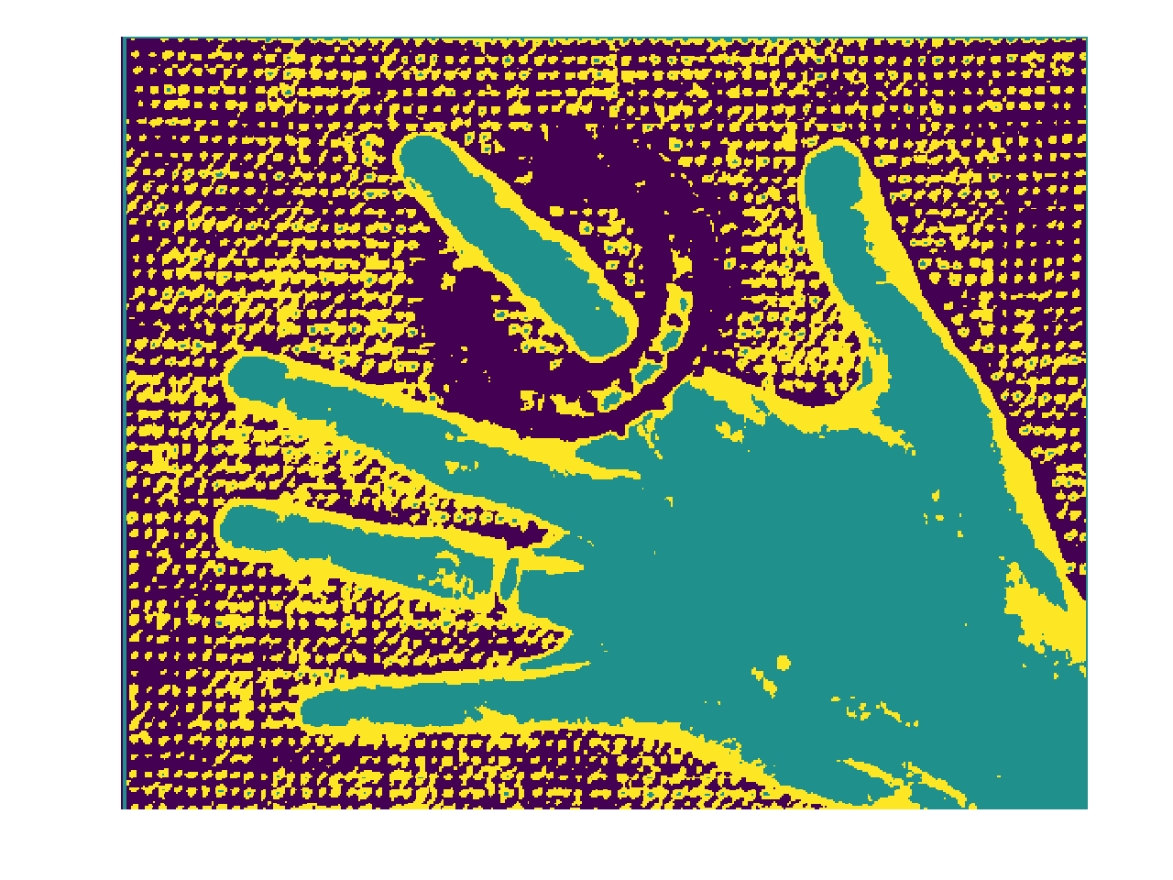


K-means on image pixels
Iteration 1
Iteration 5
Final: Iteration 17

Slide 54
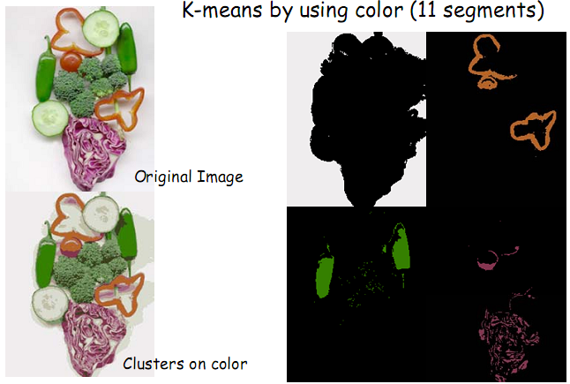
K-means on image pixels

Slide 55
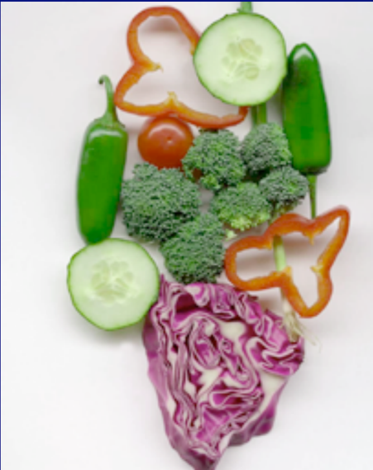
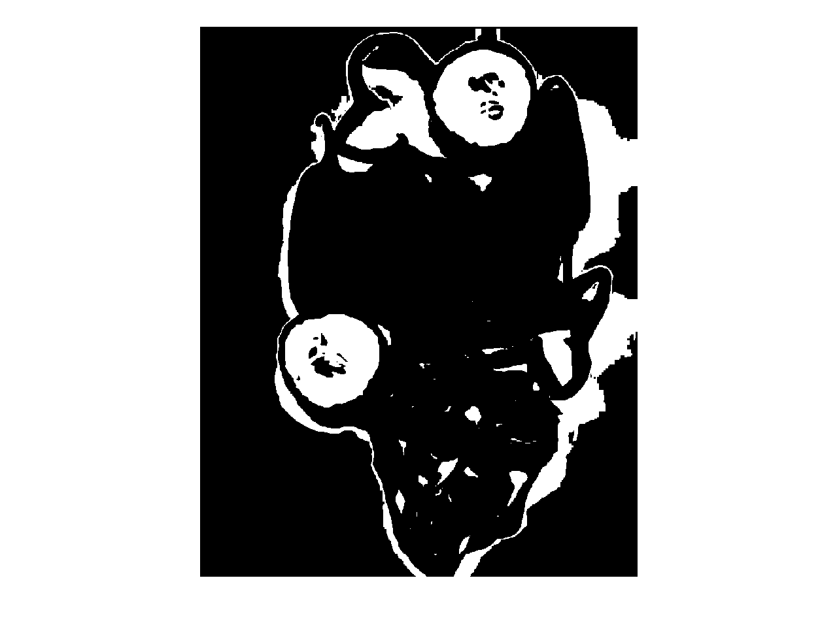
K-means on image pixels
Picture courtesy David Forsyth
One of the clusters from k-means

Slide 56

K-means on image pixels
What is wrong?
Pixel position
Nearby pixels are likely to belong to the same object
Far-away pixels are likely to belong to different objects
How do we incorporate pixel position?
Instead of representing each pixel as (r,g,b)
Represent each pixel as (r,g,b,x,y)

Slide 57

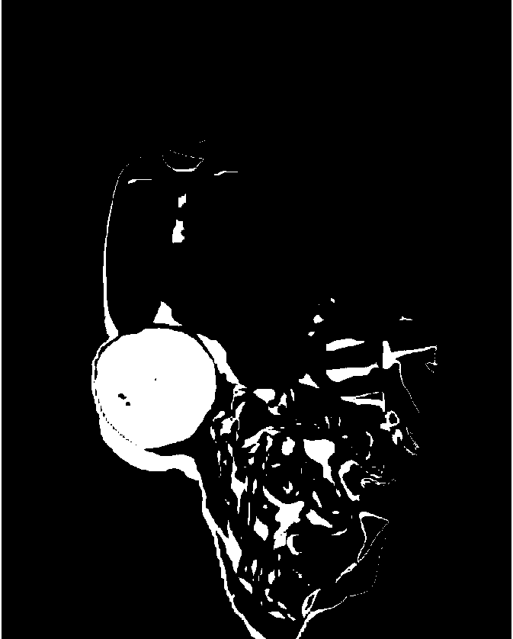
K-means on image pixels+position

Slide 58
The issues with k-means
Captures pixel similarity but
Doesn’t capture continuity of contours
Captures near/far relationships only weakly
Can merge far away objects together
Requires knowledge of k!
Can it deal with texture?

Slide 59
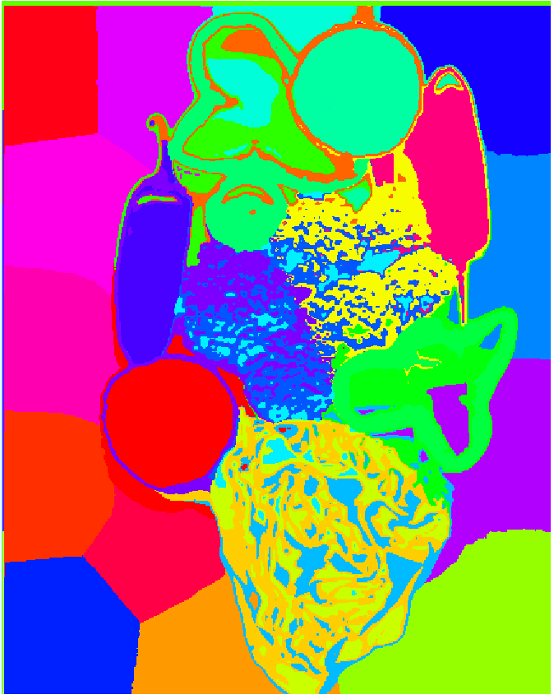
Oversegmentation and superpixels
We don’t know k. What is a safe choice?
Idea: Use large k
Can potentially break big objects, but will hopefully not merge unrelated objects
Later processing can decide which groups to merge
Called superpixels

Slide 60
MeanShift
from sklearn.cluster import MeanShift
Representing each pixel as (r,g,b)
Áp dụng cho 3 ảnh: hand.jpg, thuoc.jpg
Represent each pixel as (r,g,b,x,y)
Áp dụng cho ảnh: vegetables.jpg

Slide 61
Thực hành
Representing each pixel as (r,g,b)
Áp dụng cho 4 ảnh: vegetables.jpg, hand.jpg, thuoc.jpg và dogcat.jpg
Represent each pixel as (r,g,b,x,y)
Áp dụng cho ảnh: vegetables.jpg

